Slide 1
SMALL ANIMALS THAT FIT IN THE PALM OF YOUR HAND
BY: MS. VOCE

Slide 2
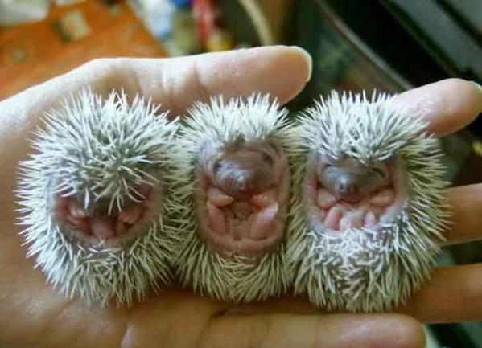
BABY HEDGEHOGS
Baby hedgehogs are born in litters of 4 to 6, and their mothers must protect them from being eaten by the father. They are born blind and without quills. However, quills sprout within the first few hours of life.

Slide 3
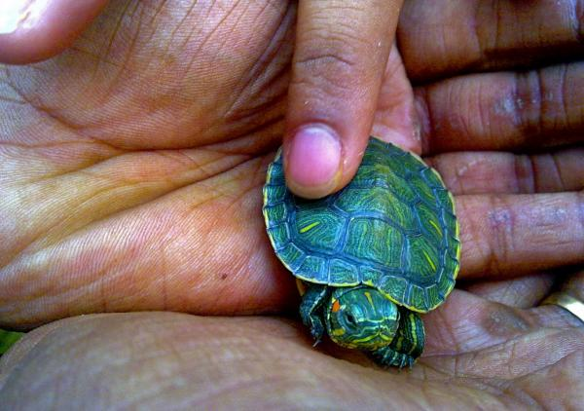
BABY TURTLES
These turtles first live in a shell for 2 months. The baby turtle is beginning a life that can last decades. They eat earthworms, small fish, greens, and fruit. Baby turtles are very slow.

Slide 4
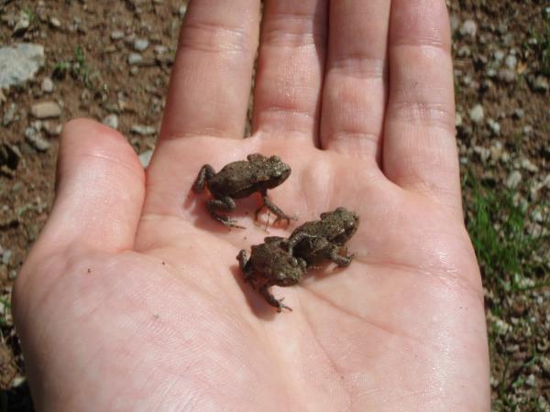
BABY TOADS
Toad tadpoles are bitter and do not taste good to predators. However, baby toads, at only 1cm long, make a great snack for their older toad relatives. Unfortunately not even a princess can save a toad – her kiss would suffocate the little creature.

Slide 5
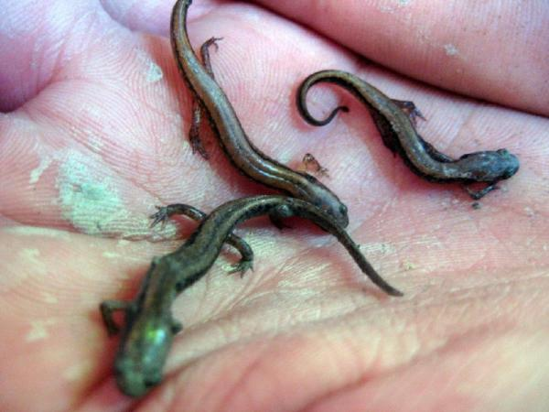
SALAMANDERS
Mother salamanders lay eggs in a shallow pond on the first rainy night each spring. The eggs have special grip, which allows them to adhere to the stem of a plant. Baby salamanders have temporary gills, enabling them to live at first in water.

Slide 6
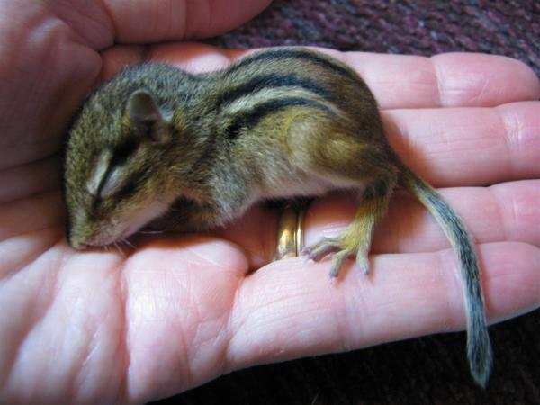
BABY CHIPMUNK
Two-inch long baby chipmunks have no fur, their eyes cannot open, and their ears are stuck to their heads. In a matter of weeks, however, they develop into a creature whose cuteness can be detected by the naked human eye.

Slide 7
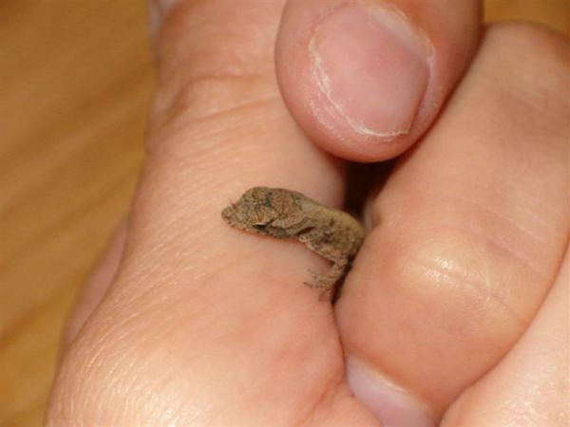
LIZARD
Lizards are a unique animal in that some breeds lay eggs, others give birth, and some lay eggs within their own bodies. The best part about caring for a pet baby lizard is that the owner is encouraged to handle it often to reinforce security and care.

Slide 8
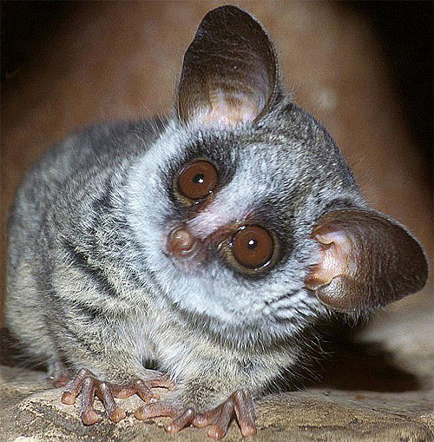
GALAGO OR BUSH BABY
The Galago or Bush Baby is a small primate which can be found mainly in Africa. No one is really sure how the term "bush baby" came to be. Maybe it is because of their sharp cry. This species is a very small primate which has an average size of approximately 5 inches (13 cm).

Slide 9
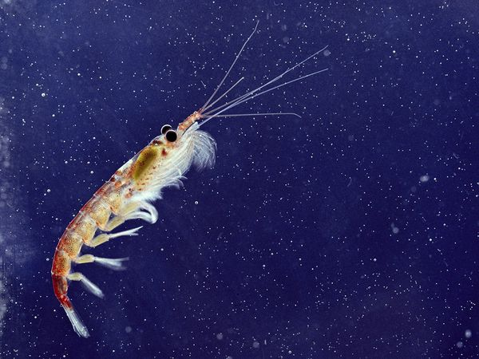
KRILL
The krill averages only about two in length It is an important part of the ocean food chain.
Krill feed on phytoplankton. They are the main food in the diets of hundreds of different animals, from fish, to birds, to baleen whales. Without krill, most of the life forms in the Antarctic would disappear.

Slide 10
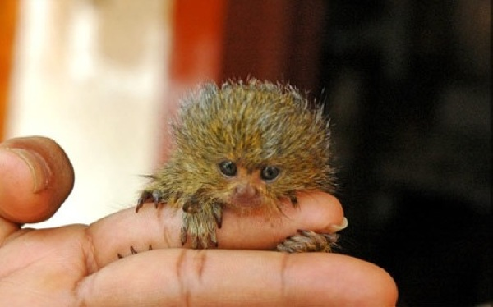
PYGMY MARMOSET
Pygmy Marmosets live in the rain forests of South America, they are the smallest monkey in the world. At 16cm tall, a full grown adult could fit inside your hand. That’s excluding the tail, which is actually longer than the monkey’s body, measuring 20cm. They usually have 2 babies, but can have 4 in captivity, and the father helps to deliver them.

Slide 11
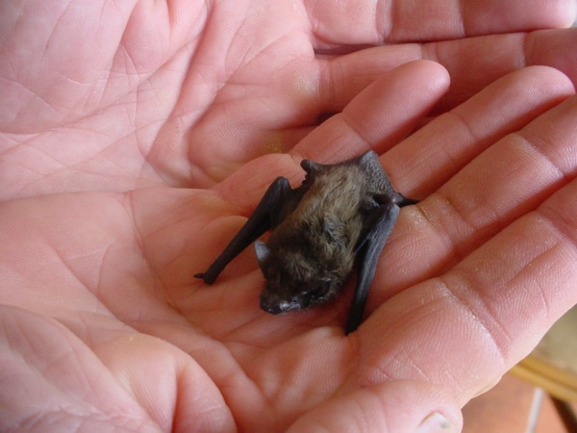
HOG-NOSED BAT
The Hog-nosed Bat is also called the bumblebee bat. It can be found in Thailand and Burma. They can grow to be about 33mm in length, which possibly makes them the smallest mammal known to man. They feed several times a day, mostly on insects. They do not use echolocation like many other bats.

Slide 12
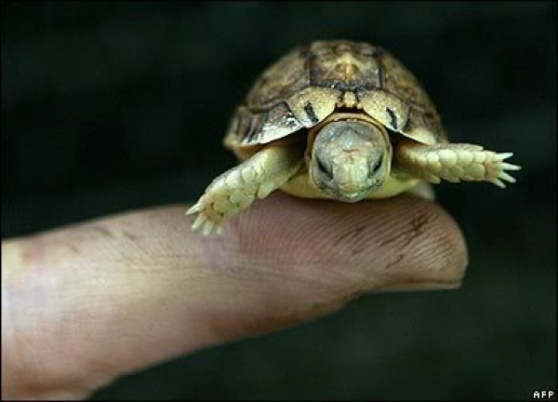
SPECKLED PADLOPER TORTOISE
The Speckled Padloper Tortoise is only 110mm. Their speckled shell helps them to hide from predators amongst rocks, where they spend most of their lives hiding. Because of their size, the females can only lay one egg at a time. They are 16 times smaller than the largest breed of tortoise, the Galapagos tortoise.

Slide 13
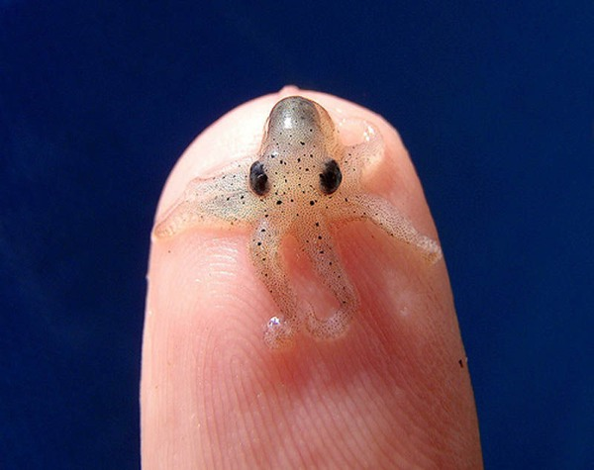
OCTOPUS WOLFI
The Octopus Wolfi is the smallest known octopus in the world. It was discovered in 1913. A full octopus wolfi will weigh less than a gram, and measure 1.5 centimeters in length. They are found in the Indo-Pacific ocean.

Slide 14
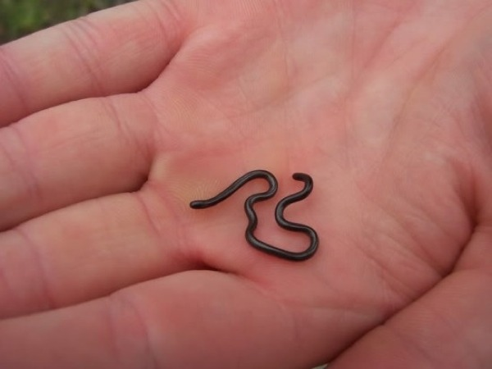
LEPTOTYPHLOPS CARLAE SNAKE
This snake is the smallest snake known to man and is also the smallest a snake can be. It is found on the island of Barbados. A fully grown adult measures about 10cm long, and is “as thin as a spaghetti noodle”. They can only lay one egg at a time.

Slide 15
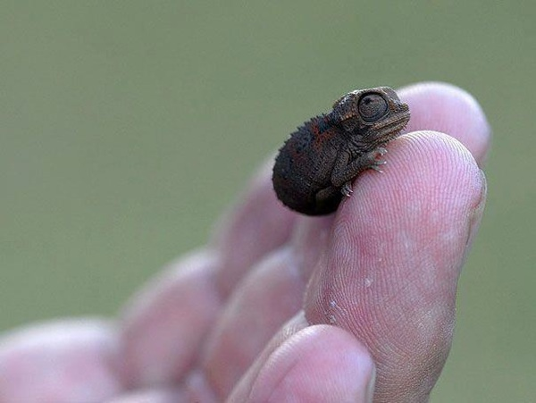
BROOKESIA MICRA LIZARD
This lizard is found in Madagascar. It is in fact a teeny chameleon, and spends most of its time under leaf litter, making it extremely difficult to locate. But at night, they climb up into the branches of trees to sleep — the best time to look for them.

Slide 16
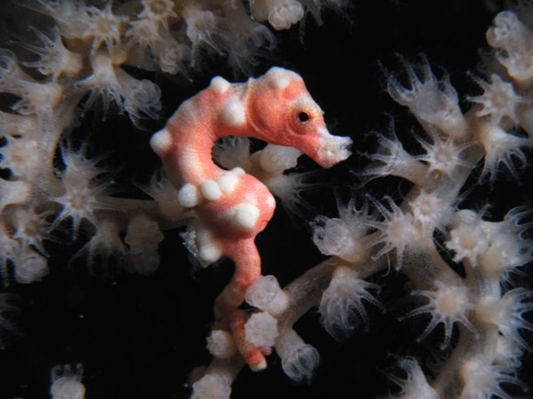
HIPPOCAMPUS DENISE
It is found between 13 and 90 meters below the surface of the Western Pacific Ocean. It was at first mistaken for a baby seahorse. A fully grown adult only grows to be about 16mm. It is hard to spot because it blends in with the coral.

Slide 17
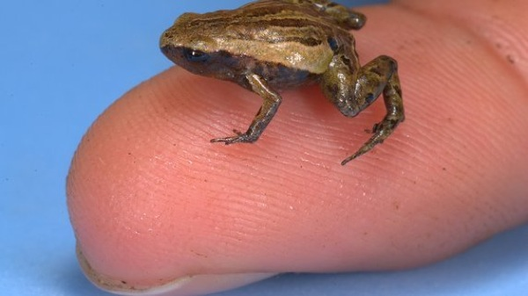
PAEDOPHRYNE AMAUENSIS FROG
This frog was discovered in 2010. It is only 7.7mm long. Found in Papua, New Guinea and lives on the floor of the rainforest. Scientists find them by listening to their high pitched calls. The frogs are so small, that a fully grown adult could fit completely on one of your fingernails. It is the smallest frog in the world and also the smallest vertebrate known to man.

